Slide 1
Lecture 12: Thevenin Equivalents
Review of I-V Linear Equation
Thevenin Equivalent Circuit
Effective Resistance in Linear network
Calculating R_{eff} by Removing Sources
Problem Strategy and Practice

Slide 2

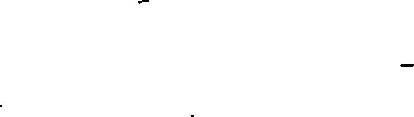

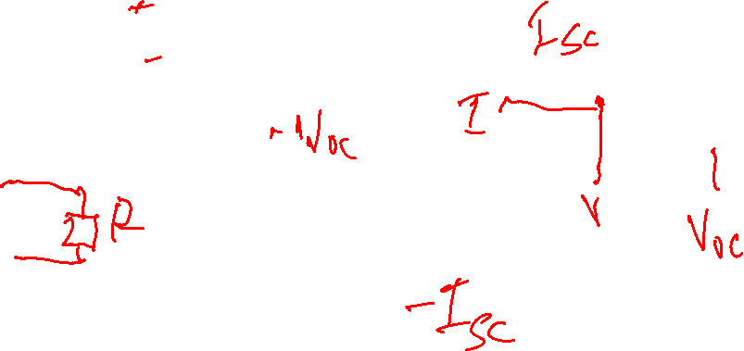
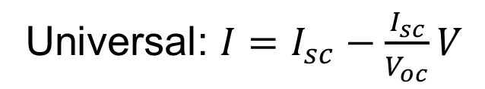
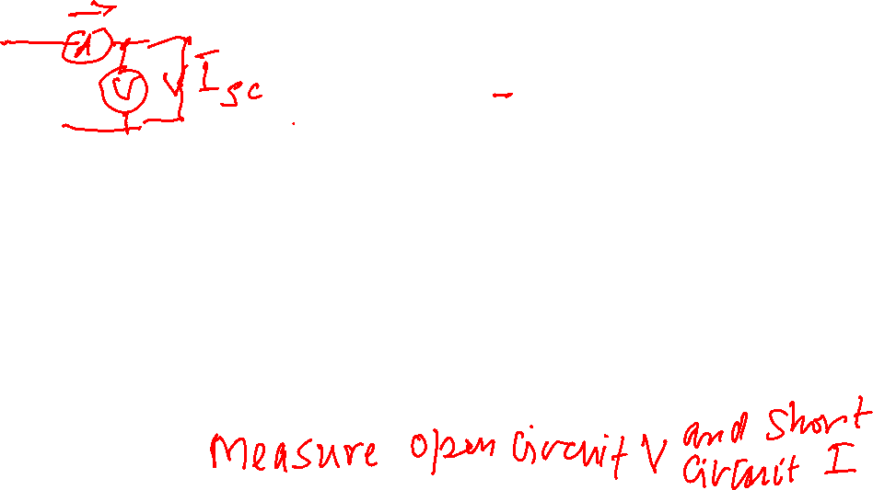
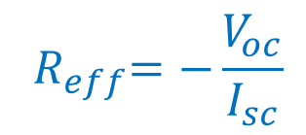

Relating I-V Line to Equation
Unknown circuit “C” may be made up of multiple voltage and current sources connected by a resistor network
$${ R}_{eff}=\frac{V_{oc}}{I_{sc}}$$
I
C
+
V
-
$$I=I_{sc}−\frac{1}{R_{eff}}V$$
I
I
C
+
V
-
I
$${ R}_{eff}=−\frac{V_{oc}}{I_{sc}}$$
$$I=I_{sc}+\frac{1}{R_{eff}}V$$
Universal: $I=I_{sc}−\frac{I_{sc}}{V_{oc}}V$

Slide 3
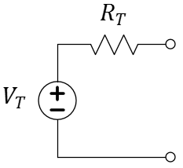
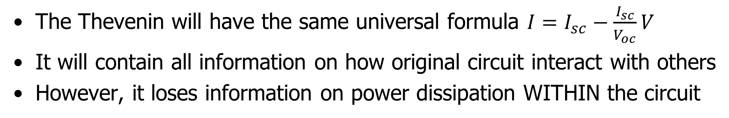

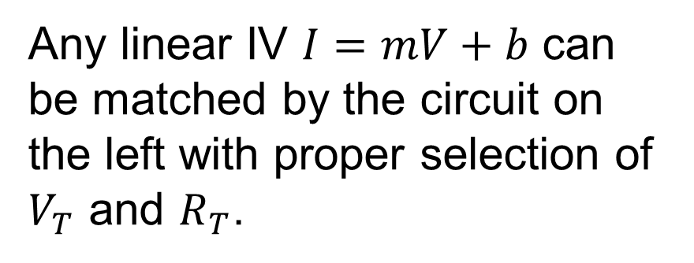
Thevenin Equivalent
Any linear IV $I=mV+b$ can be matched by the circuit on the left with proper selection of $V_{T}$ and $R_{T}$.
The Thevenin will have the same universal formula $I=I_{sc}−\frac{I_{sc}}{V_{oc}}V$
It will contain all information on how original circuit interact with others
However, it loses information on power dissipation WITHIN the circuit

Slide 4
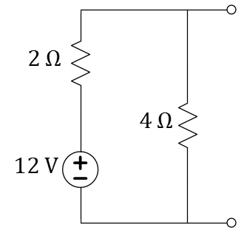
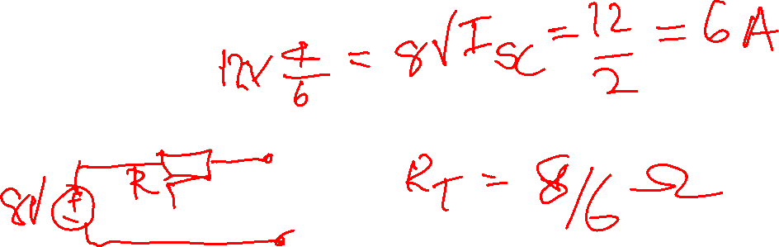
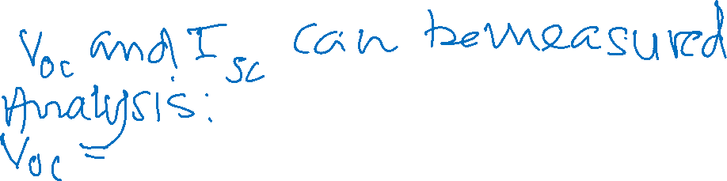

Example
Q: Discuss different ways can you find $I=mV+b$ for this circuit.
Q: What is the Thevenin equivalent of the circuit?

Slide 5
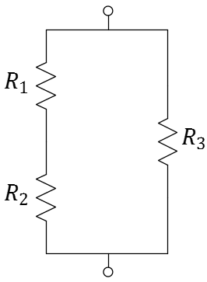
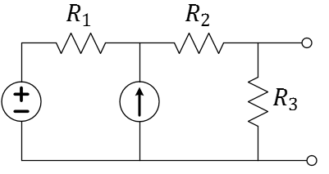
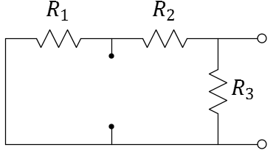


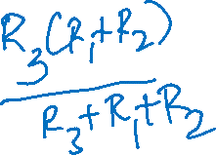

Effective Resistance: R_{eff} = R_{T} = R_{N} is R_{eq} with sources “zeroed”
Short-circuit all voltage sources (i.e. set them to zero)
Open-circuit all current sources (i.e. set them to zero)
Find resulting $R_{eq}$ using parallel and series relationships
$$⇒$$
$$⇒$$
Q: How is $R_{eff}$ related to the slope of the I-V line?

Slide 6
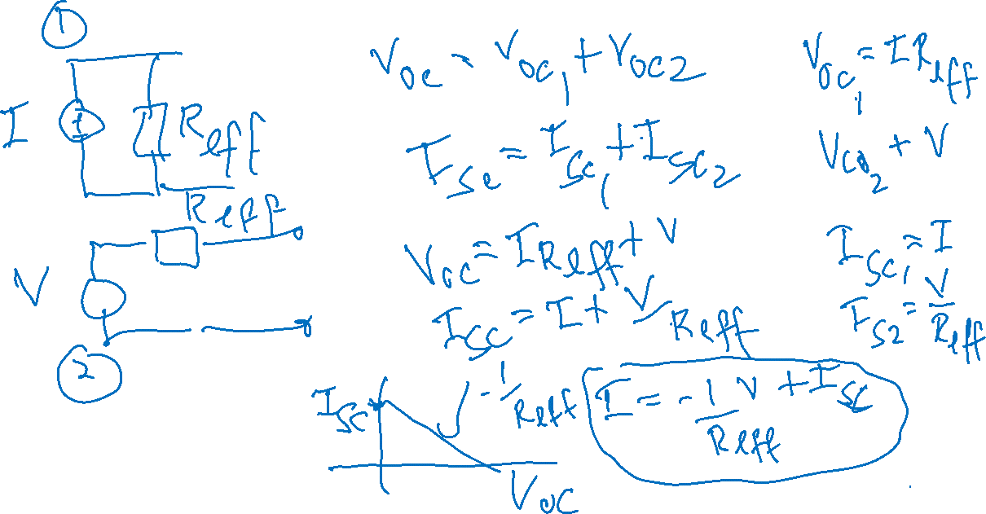

Slide 7
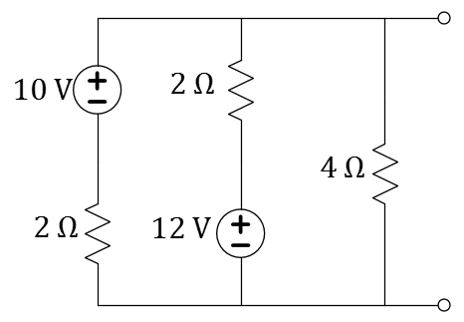
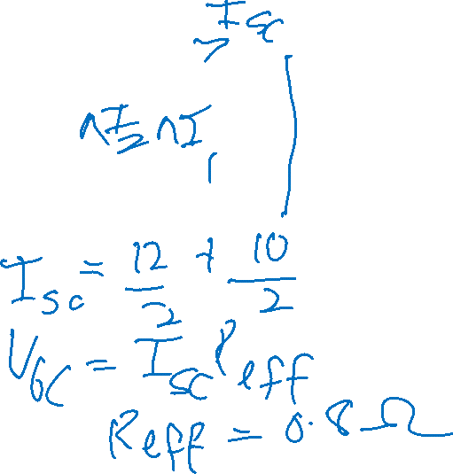

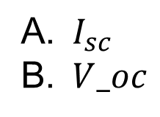

Finding R_{eff} is easy in multi-source circuits
Q: What is $R_{eff}$, for the circuit?
Q: Besides $R_{eff}$, is it easier to find $I_{SC}$ or $V_{OC}$?
$8 Ω$
$5 Ω$
$4 Ω$
$2 Ω$
$0.8 Ω$
$I_{sc}$
$V_oc$
Notes:
E for the first question; Arguably A for the second question since it removes 4 Ohms and makes it two simple loops.

Slide 8





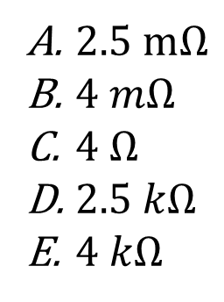



One can find a circuit given a line
$$R_{eff}$$
$$R_{eff}$$
$2.5 mΩ$
$4 mΩ$
$4 Ω$
$2.5 kΩ$
$4 kΩ$
Q: What is $R_{eff}$, for the circuit with the given I-V line?
Notes:
Note that the configuration is non-standard (non-SRS).
5/2m = 2.5 k, D.

Slide 9
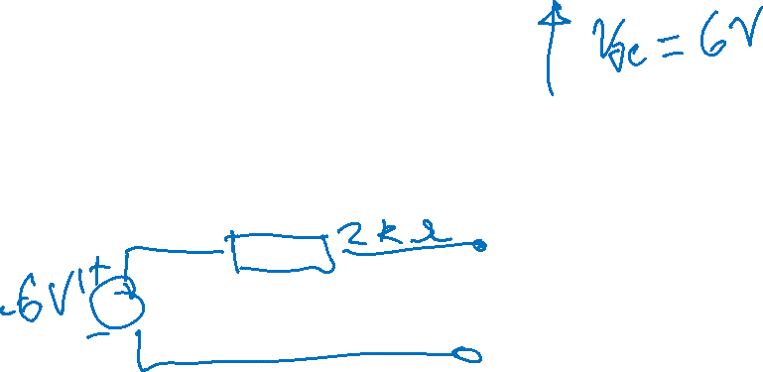
Practice makes perfect!
In History…
Leon Charles Thevenin was a telegraph engineer. In 1883, his theorem expanded modelling of circuits and simplified circuit analysis based on Ohm’s Law and Kirchhoff’s Laws.
The dual “Norton’s theorem” didn’t arrive until 1926 with the efforts of Bell Labs engineer, Edward Lawry Norton.
Q: What is the Thevenin equivalent for the circuit above?
Notes:
Although it carries Norton’s name, the theorem was independently found the same year by Siemens & Halske researcher, Hans Ferdinand Mayer.
We probably should have used a different circuit since this one was already (kind of) discussed earlier. Maybe just remind them or do it fast.

Slide 10
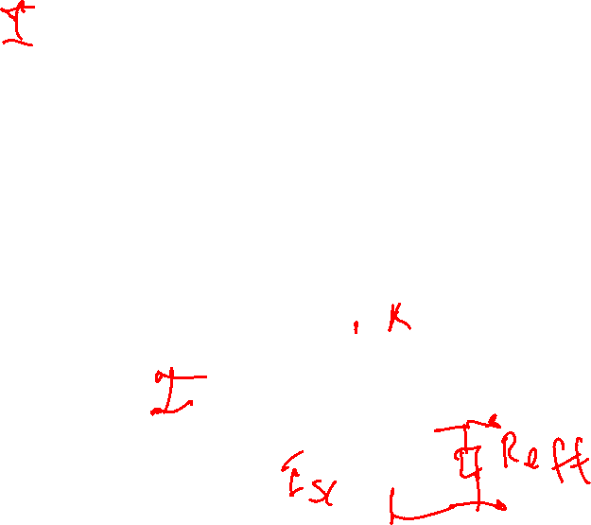
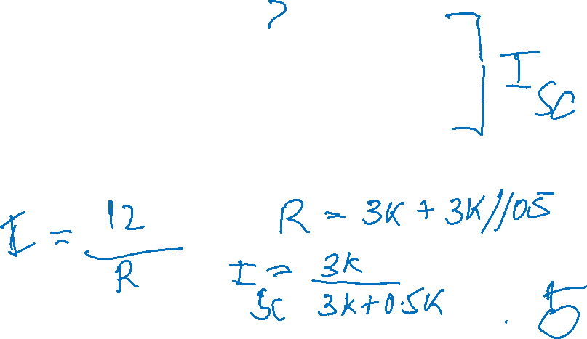
Practice makes perfect!
In History…
Leon Charles Thevenin was a telegraph engineer. In 1883, his theorem expanded modelling of circuits and simplified circuit analysis based on Ohm’s Law and Kirchhoff’s Laws.
The dual “Norton’s theorem” didn’t arrive until 1926 with the efforts of Bell Labs engineer, Edward Lawry Norton.
Q: What is the Norton equivalent for the circuit above?
Notes:
Although it carries Norton’s name, the theorem was independently found the same year by Siemens & Halske researcher, Hans Ferdinand Mayer.
We probably should have used a different circuit since this one was already (kind of) discussed earlier. Maybe just remind them or do it fast.

Slide 11
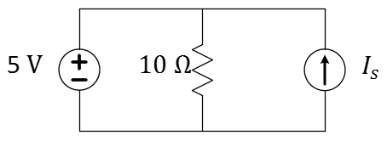
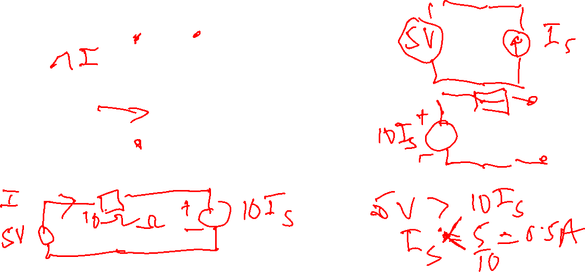
Flashback! Use Thevenin to solve.
Q: For what values of I_{s} does only the voltage source supply power?
Notes:
Here we discuss the sign for the power from the physical consideration, not the sign shortcut. This can take quite a bit of time depending on how you want to approach it. At a minimum, write the equation for power and decide under what conditions P_1 < 0. Since 5V > 0, the focus becomes how to ensure that I_1 flows up through the 5-v source.

Slide 12
Notes:
Left blank to keep every lecture at an even number of slides for printing two slides per sheet at Stipes. Students may also appreciate the extra space for the previous problem.

Slide 13
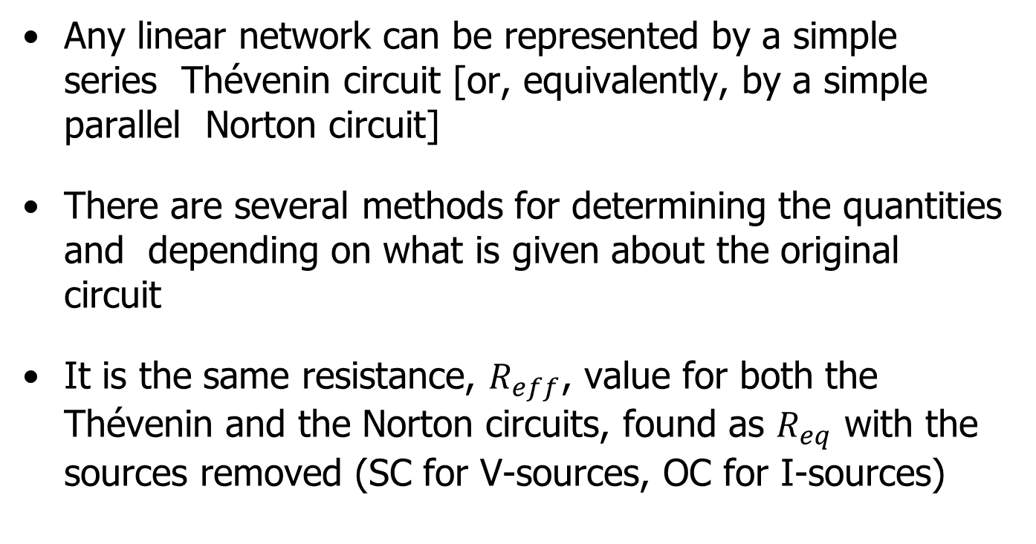
Summary
Any linear network can be represented by a simple series Thévenin circuit [or, equivalently, by a simple parallel Norton circuit]
There are several methods for determining the quantities and depending on what is given about the original circuit
It is the same resistance, $R_{eff}$, value for both the Thévenin and the Norton circuits, found as $R_{eq}$ with the sources removed (SC for V-sources, OC for I-sources)

Slide 14
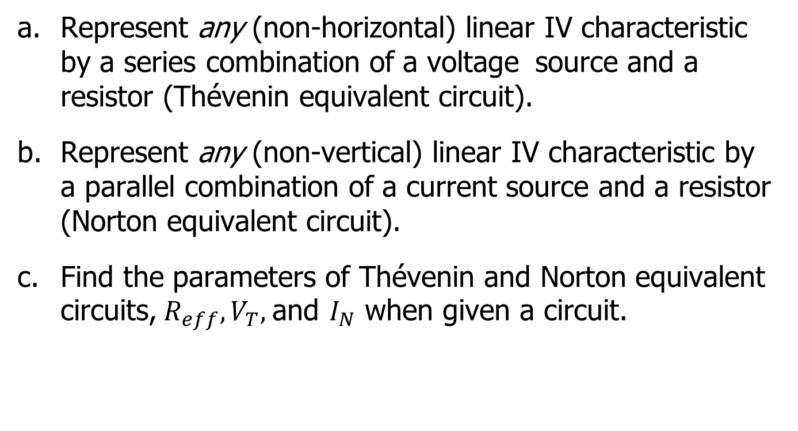
L12 Learning Objectives
Represent any (non-horizontal) linear IV characteristic by a series combination of a voltage source and a resistor (Thévenin equivalent circuit).
Represent any (non-vertical) linear IV characteristic by a parallel combination of a current source and a resistor (Norton equivalent circuit).
Find the parameters of Thévenin and Norton equivalent circuits,${ R}_{eff}, V_{T},$and $I_{N}$ when given a circuit.

